Slide 1
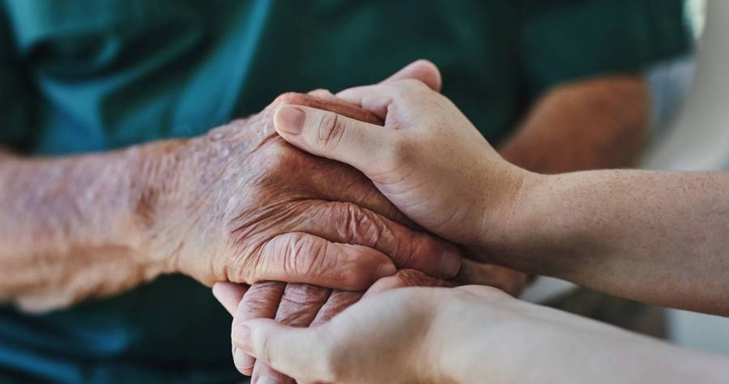
Unlocking Patient Preferences: A Comprehensive Analysis of Dermatology Clinic Services
Submitted by,
Aiswarya Parayil
aiswaryaparayil1907@gmail.com

Slide 2
Contents
1)Purpose--------------------------------------------------------------------------------------- 03
2)Scope---------------------------------------------------------------------------------------- -04
3)Overview------------------------------------------------------------------------------------- 05
4)Approach------------------------------------------------------------------------------------- 06
5)Tools Used----------------------------------------------------------------------------------- 07
6)Gender based analysis--------------------------------------------------------------------- -08
7)Age based analysis------------------------------------------------------------------------- -11
8) Demand analysis--------------------------------------------------------------------------- 13
9)Analysis using excel------------------------------------------------------------------------ 14
10) Analysis using gcollab--------------------------------------------------------------------16
11) Recommendations-------------------------------------------------------------------------18

Slide 3
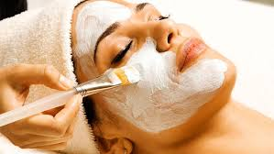
Purpose
This project aims to examine the major variables affecting patient behaviour and satisfaction in dermatology offices. We hope to get insight into the target region's most sought-after dermatological services, frequency of service use, and factors influencing clinic choice through this study. The results of this analysis will offer dermatology centers in the area practical suggestions for enhancing their customer service, service offerings, and competitive positioning.
This study primarily focusses on the city of Bangalore and incorporates data that was gathered from several Bangalore-based clients.

Slide 4
Scope
This study focusses on how people in a certain target location use dermatology services and what their preferences are, taking into account things like;
Frequency of dermatology clinic appointments
Services desired (e.g., wellness, anti-aging, skin treatments).
Patient contentment with the clinics they visit now.
Key factors determining clinic choice, including location, cost, quality of services, and awareness.
The impact of social media, word-of-mouth, and marketing channels on clinic awareness.
Examination of differences in service satisfaction and preferences based on demographics.
Administrators of dermatology clinics, healthcare marketers, and other stakeholders looking to improve clinic services and client retention will find the data useful.

Slide 5
Overview
The data used in this study was gathered from patients who use dermatology services in the target region, representing a variety of demographics. Responses on factors influencing clinic selection, satisfaction levels, preferences for clinics, and frequency of services are all included in the dataset. The project's objectives are to identify trends, produce new ideas, and offer suggestions for enhancing dermatology patient experiences. The undertaking entails: 1)Preparing and cleaning data to guarantee dependability and accuracy. 2)Statistical study helps identify the main patterns in the use of services. 3)Patient satisfaction data visualization together with contributing factors.

Slide 6
Approach
Data Collection and Cleaning:
The initial dataset was reviewed for any missing values or inconsistencies.
Data cleaning steps included standardizing responses, correcting any formatting errors, and addressing missing data.
Exploratory Data Analysis:
A detailed exploratory analysis was conducted to understand the distribution of demographic factors, service usage frequency, clinic types, and satisfaction levels.
Cross-tabulations and summary statistics were used to identify key patterns.
Visualization and Reporting:
Visualizations such as bar charts, histograms, and pie charts were created using Power BI to effectively present trends in patient preferences and clinic satisfaction.
A PowerPoint presentation was created to summarize the findings, focusing on the main factors influencing clinic choices and satisfaction.
Recommendations:
Actionable recommendations were developed based on the findings to enhance service offerings, customer satisfaction, and clinic visibility.

Slide 7
Data set provided :
Click here to get link: :https://mail.google.com/mail/u/0?ui=2&ik=5bcdc5123f&attid=0.1&permmsgid=msg-f:1811057715426653760&th=19222b6593bc7640&view=att&disp=safe&realattid=f_m1g1lalw0
Data set after preprocessing :
imira.xlsx
Tools Used
MS Power bi DERMATOLOGY STUDY.pbit
Google collabhttps://colab.research.google.com/drive/1xnJ_xyWRht0L2WnZ4cvFTHriste0wmvv?usp=sharing
MS Excel: imira.xlsx

Slide 8
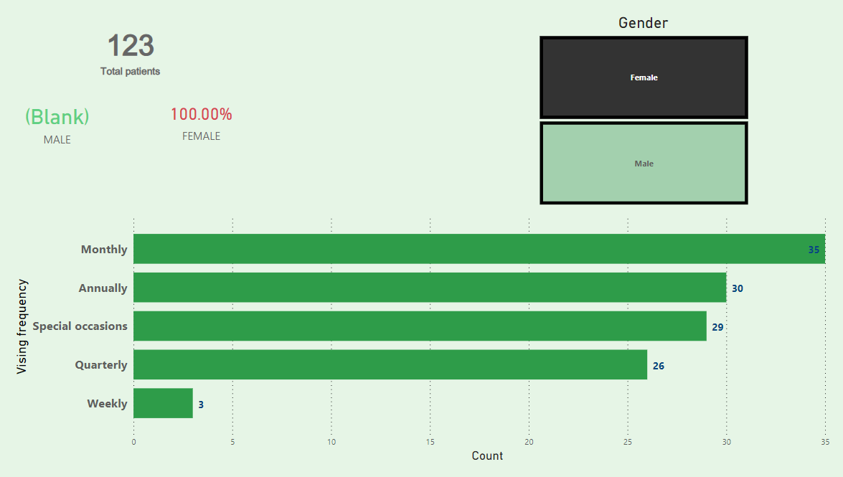
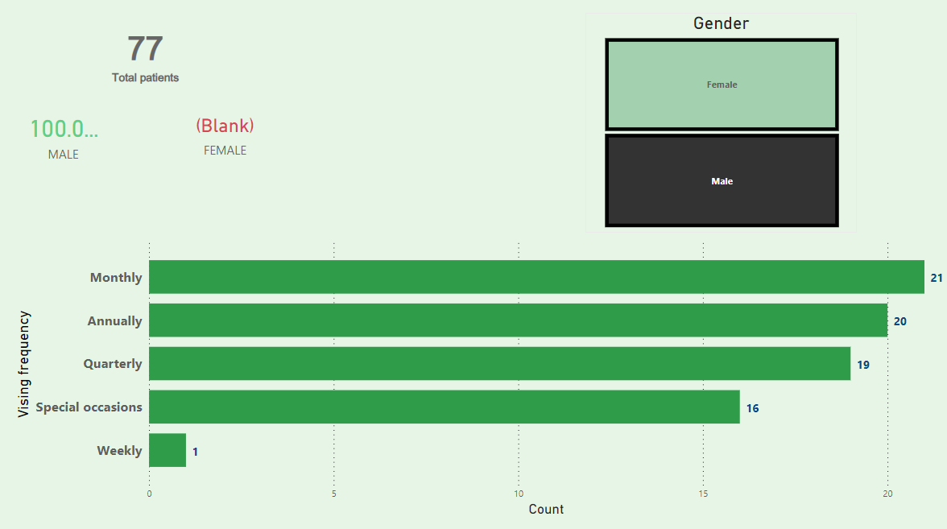
Gender based data analysis
Female Visit Patterns: A majority of females visit dermatology clinics either on a monthly or annual basis, indicating a focus on both routine care and specialized treatments at different intervals.
Male Visit Patterns: Among males, monthly visits are the most common, suggesting a steady demand for dermatological services, possibly for ongoing treatments or skin health maintenance.

Slide 9
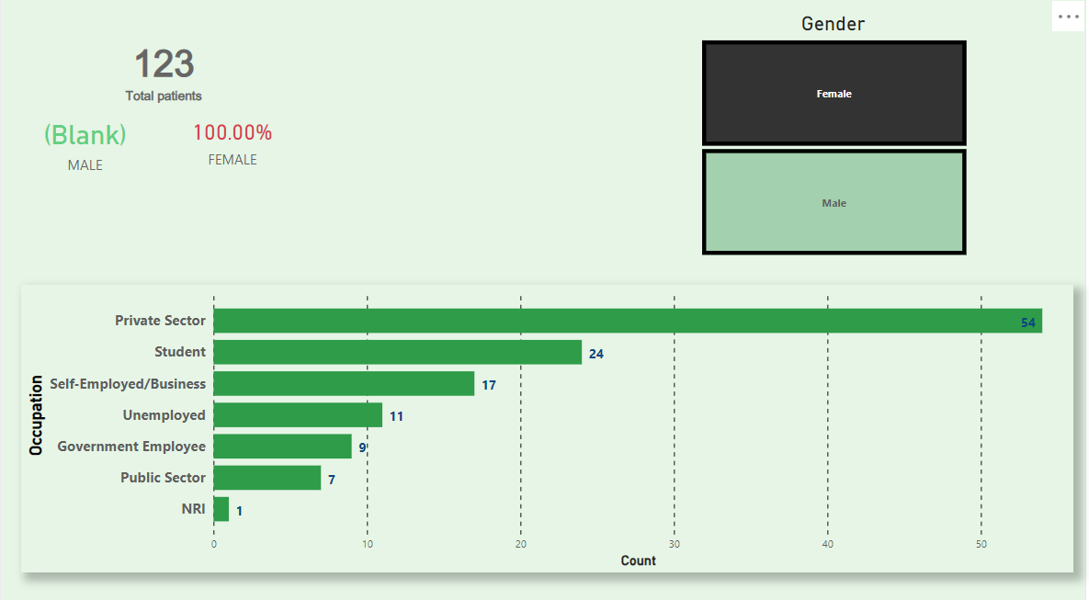
Occupation Insights: For both males and females, individuals working in the private sector are the most frequent visitors to dermatology clinics, highlighting the influence of income stability and perhaps workplace-related skincare concerns.
Students and Gender Differences: Female students visit dermatology clinics more frequently than male students, reflecting a higher demand for skin treatments or beauty-related services among young women.

Slide 10
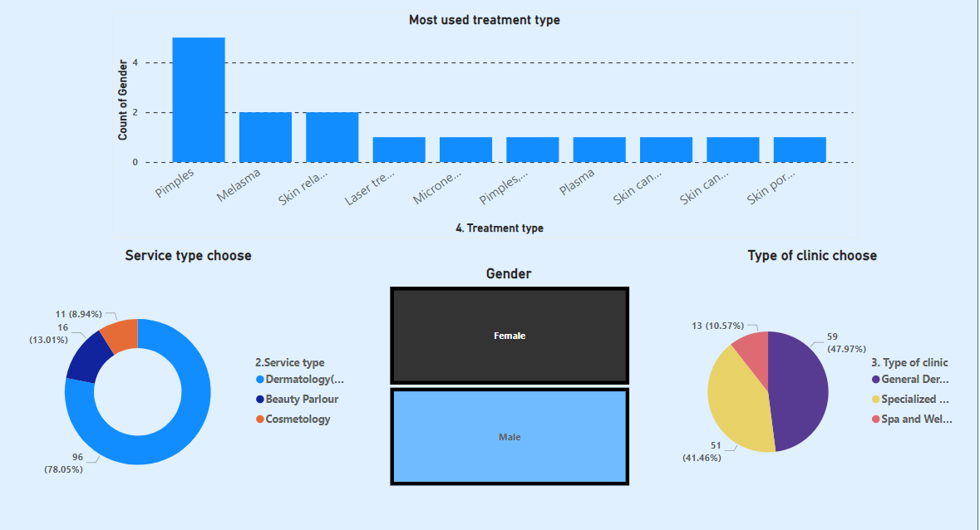
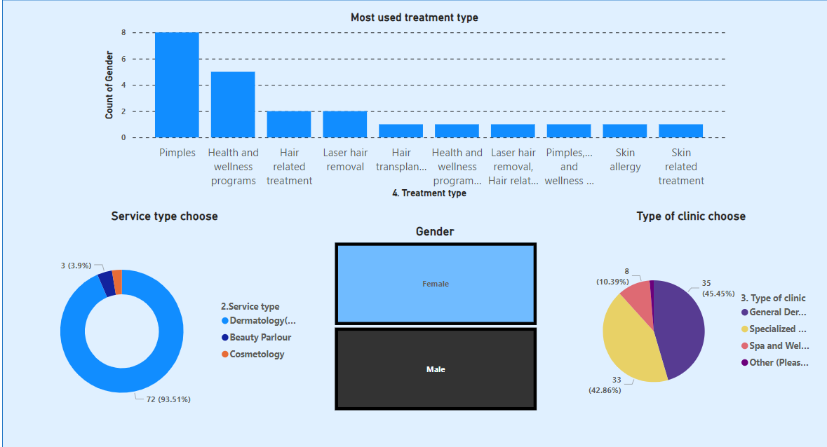
Female Clinic Preferences: Most women visit clinics for pimples or melasma treatments, and predominantly choose general dermatology or specialized dermatology departments. Fewer women opt for services in cosmetology departments or spa/beauty parlors, indicating a stronger focus on medical dermatology rather than aesthetic treatments.
Male Clinic Preferences: Men typically seek dermatology services for pimples, health and wellness treatments, and hair care. Similar to women, men favor general and specialized dermatology clinics while showing lower preference for spa or beauty parlor services.

Slide 11
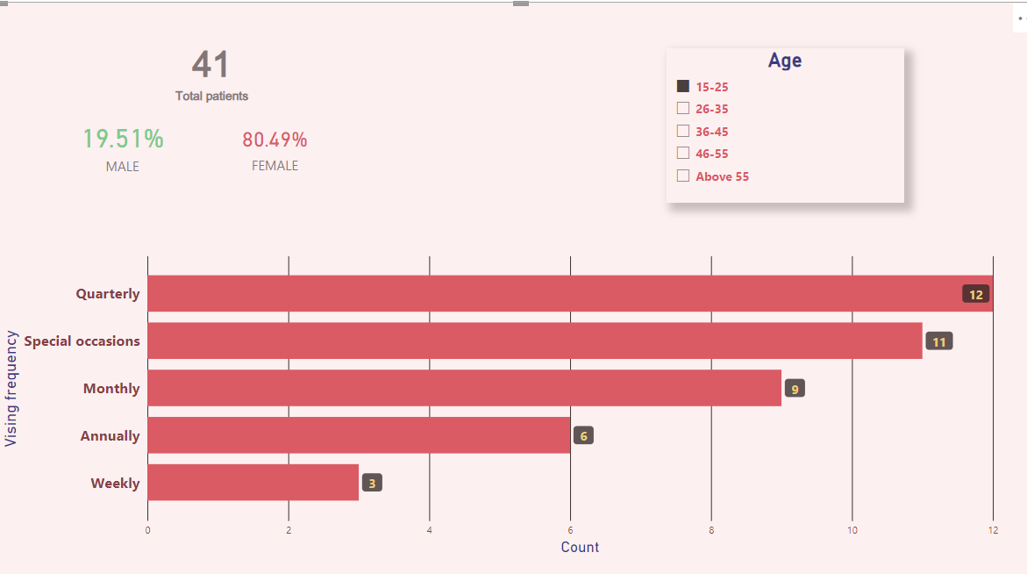
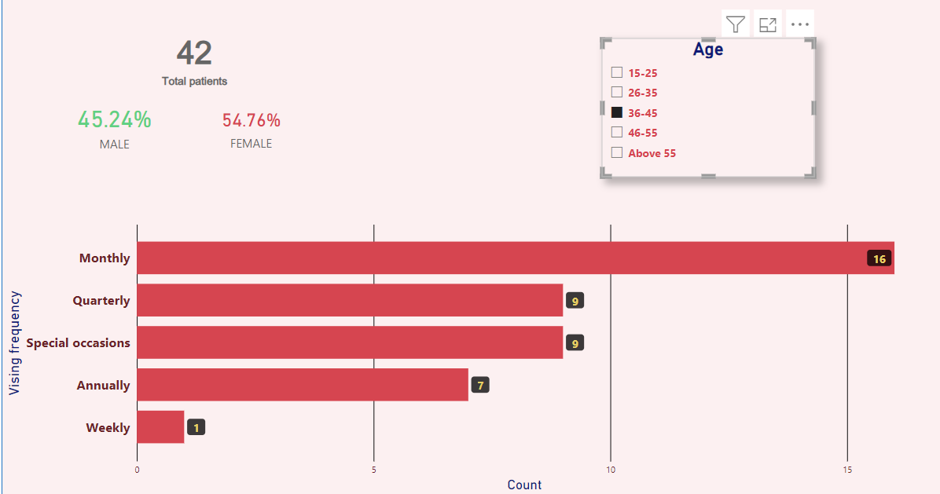
Age based analysis
Age Group 15-25: Individuals in the 15-25 age category tend to visit dermatology clinics quarterly or during special occasions. This suggests they might seek treatments for occasional concerns or special events.
Age Group 26-35: People in the 26-35 age group typically opt for annual visits or appointments on special occasions, likely indicating they maintain a more selective approach to dermatology services, possibly for maintenance or preventive care.
Age Group 36-45: Those in the 36-45 age bracket most frequently visit dermatology clinics either monthly or quarterly, reflecting a more consistent need for skincare services, perhaps due to age-related concerns or regular maintenance treatments.
Age Group 46-55: The 46-55 age group shows a preference for monthly or annual visits, indicating a balance between routine dermatological care and preventive health check-ups.

Slide 12
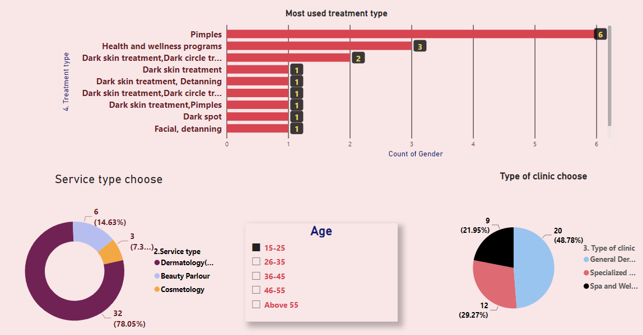
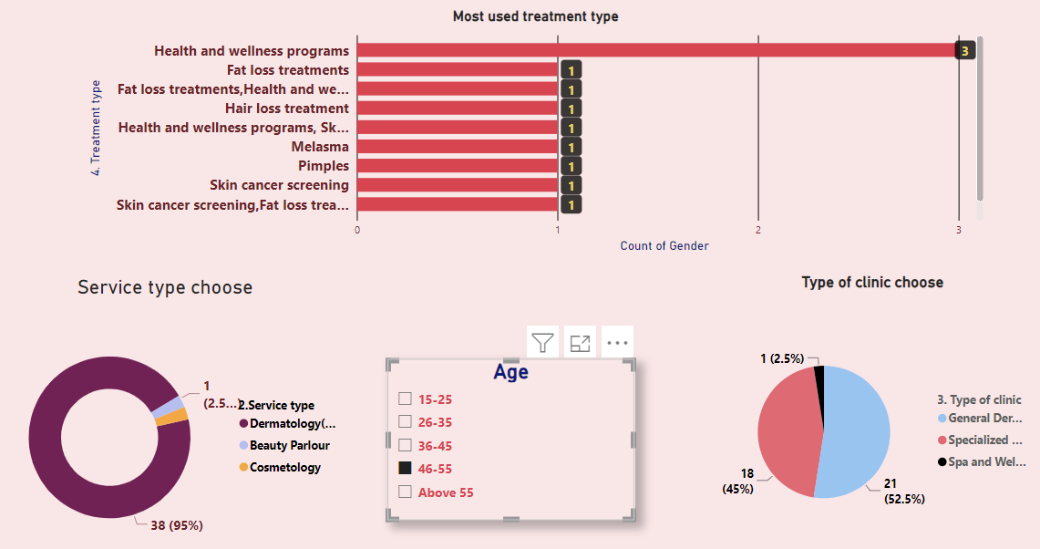
Age Group 15-25: Individuals in the 15-25 category predominantly visit clinics for concerns related to pimples and health and wellness, with fewer visits for facial or de-tanning treatments. They primarily choose general dermatology or specialized dermatology departments for their needs.
Age Group 26-35: This group exhibits similar preferences as the 15-25 age group, opting for clinics to address pimples, health and wellness issues, and showing a preference for general and specialized dermatology departments rather than cosmetology or spa services.
Age Group 36-45: Individuals in this 36-45 age group use clinics for a wide range of treatments, including pimples, wellness, darkness treatments, and anti-aging. They distribute their visits across general dermatology, specialized dermatology, and cosmetology departments fairly evenly.
Age Group 46-55: People in the 46-55 age group focus more on health and wellness treatments, and prefer general dermatology and specialized dermatology departments, similar to younger age groups but with a broader range of health-related concerns.

Slide 13
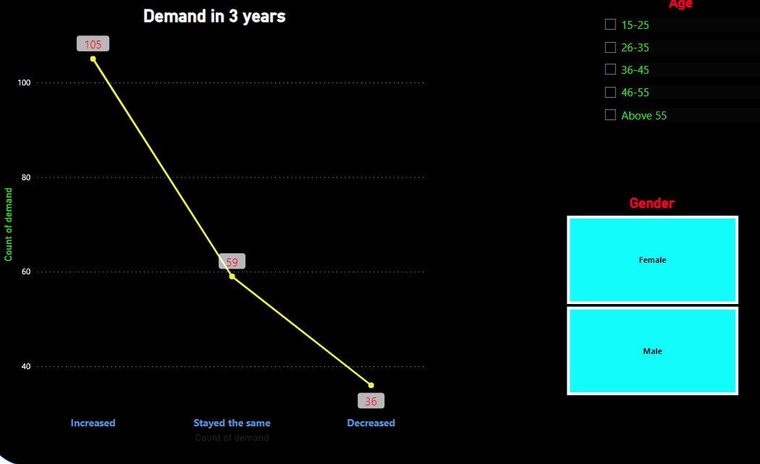
Above 55 Age Group: Individuals above 55 mainly visit clinics for anti-aging treatments, addressing concerns like dark spots and skin texture, with preferences for specialized dermatology services aimed at slowing down aging processes and maintaining skin health.
This breakdown reveals how treatment priorities shift across age groups, with younger individuals focused on common skin issues like pimples, while older groups focus more on wellness, anti-aging, and skin maintenance.
Demand Analysis

Slide 14
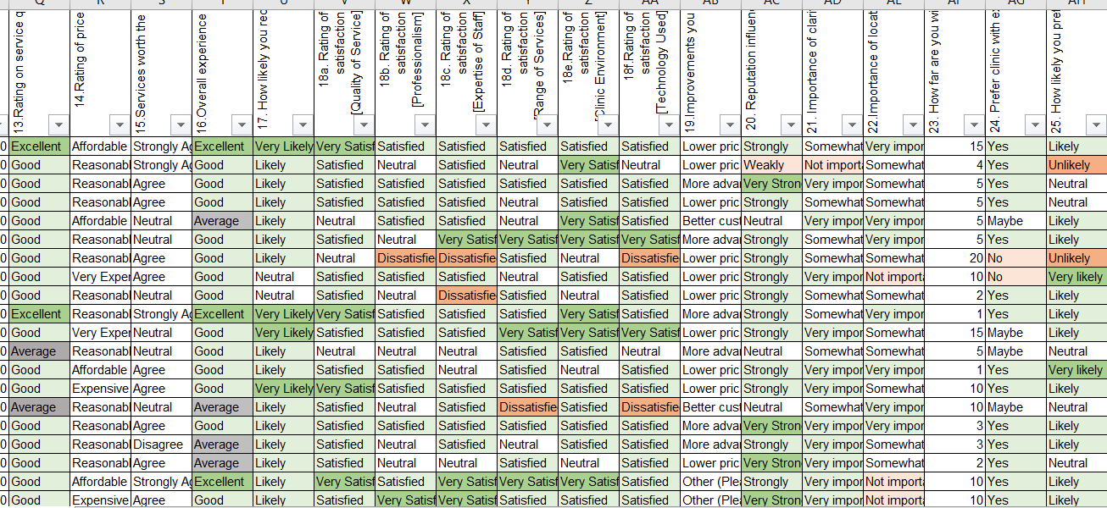
The demand for dermatology clinics has increased for most individuals over the past three years, with only a few remaining the same and a small number experiencing a decrease.
Analysis using MS Excel

Slide 15
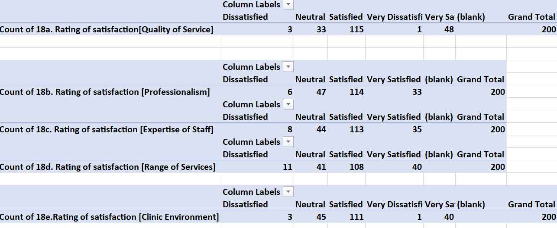
The results from the Excel Pivot Table indicate that most participants are satisfied with the quality of service, professionalism, expertise, the services provided, and the use of new technology

Slide 16
Analysis using Google collab
Awareness of Clinics: The most recognized clinics are ‘Iskin clinic’ and ’ Yuvana clinic’, whereas ‘Luna Clinic’ has the least awareness among participants.
Most Visited Clinic: Olivia Skin & Hair Clinic is the most frequently visited clinic.
Source of Awareness: Participants primarily hear about clinics from friends and family, with social media being a lesser source and advertisements having minimal impact.
Influence of Media: Customers are most influenced by Instagram and clinic websites, while TV advertisements have a significantly lower influence.
Influencing Factors: The key factors influencing customers are the technology used and customer reviews, while they are less concerned about the clinical environment.
Treatment Duration: Most participants have been receiving treatment for less than six months.
Pricing Opinion: The majority consider the pricing to be reasonable.
Suggested Improvements: Participants suggest that improvements could be made by incorporating more advanced technologies and lowering prices.
Average Travel Distance: On average, participants travel 15 kilometers for treatment.
Preferred Clinic Hours: Most participants prefer extended hours over weekend availability for appointments.

Slide 17
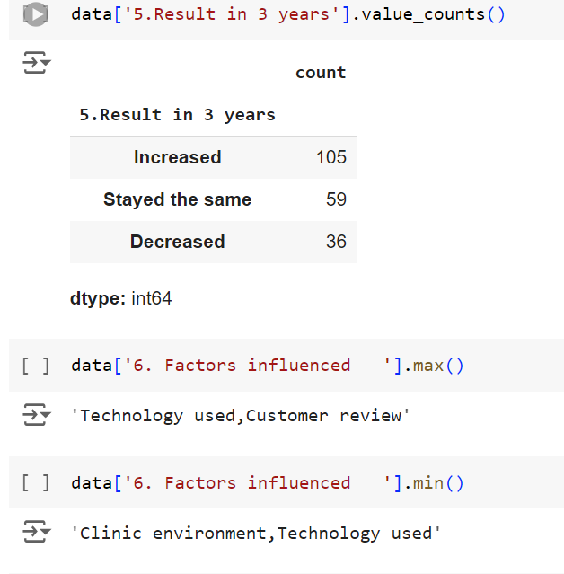
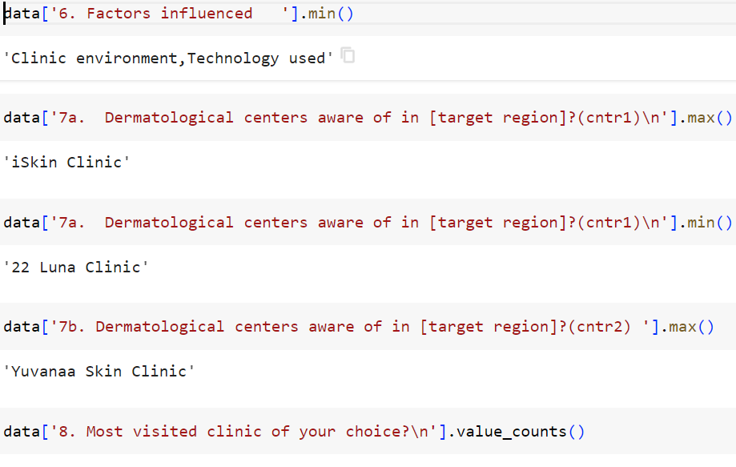

Slide 18
Recommendations:
Enhance Technology Adoption:
Invest in advanced dermatological technologies and equipment to improve treatment options and outcomes. Highlight these advancements in marketing materials to attract tech-savvy customers.
Focus on Customer Reviews:
Actively encourage satisfied customers to leave positive reviews online and share their experiences on social media platforms. This can enhance the clinic's reputation and attract new clients.
Maintain Reasonable Pricing:
Keep pricing competitive while exploring options for bundled services or loyalty discounts to retain clients. Consider periodic promotions or packages to encourage repeat visits.
Expand Treatment Options:
Introduce a broader range of services to cater to diverse customer needs, ensuring that both popular and specialized treatments are available.
Optimize Clinic Hours:
Consider extending clinic hours during weekdays to accommodate clients who prefer flexibility over weekend visits. This can help increase patient flow and satisfaction.
Strengthen Referral Programs:
Develop referral programs that incentivize existing clients to recommend the clinic to friends and family, leveraging the strong word-of-mouth influence observed.

Slide 19
Enhance Marketing Strategies:
Utilize targeted digital marketing campaigns, particularly on social media platforms like Instagram, to reach potential customers effectively. Create engaging content that showcases success stories, treatment processes, and patient testimonials.
Accessibility Considerations:
Evaluate clinic locations to ensure they are accessible to patients within a reasonable travel distance. Consider the possibility of opening additional branches in underserved areas to increase reach.
Engage with the Community:
Participate in local health fairs, workshops, or seminars to raise awareness about dermatological health and the services offered. This can enhance community engagement and brand visibility.
Gather Patient Feedback:
Regularly collect and analyze patient feedback to identify areas for improvement. Use surveys or suggestion boxes to understand patient needs and preferences better.
By implementing these recommendations, dermatology clinics in Bangalore can enhance patient satisfaction, attract new clients, and improve overall service delivery.

